Slide 1

Principle of marketing
Represent by:
Syeda noor Fatima naz
Anam Akhtar
Nimra riaz
maria aslam
Farwa zahoor
Hamza razzaq
Sheraz haider
1

Slide 2

TECH PC’z
Your Choice, our pride
2

Slide 3

What is Tech PC’z?
Tech PC'z is a name of brand in which Computer, Laptops, Gaming PC and its parts and so on are sold.
Tech PC'z has different retail stores all over Pakistan and sell genuine parts and with a long time warranty.
Tech PC'z also have trained engineers to take care of Client's Computer.

Slide 4





Topics to be Covered
4P’s
Segmentation
Target Market
Market Position
SWOT Analysis
6
7
Perceptiual Map
Adds

Slide 5
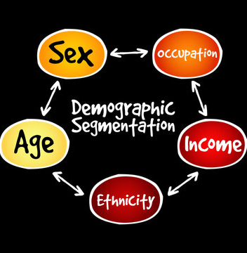
Segmentation
Demographic Segmentation
Segmentation by Education
School and College Students
Special Offers and Discounts for Students
Special Discounts to Schools and Colleges in establishing Computer LABs

Slide 6
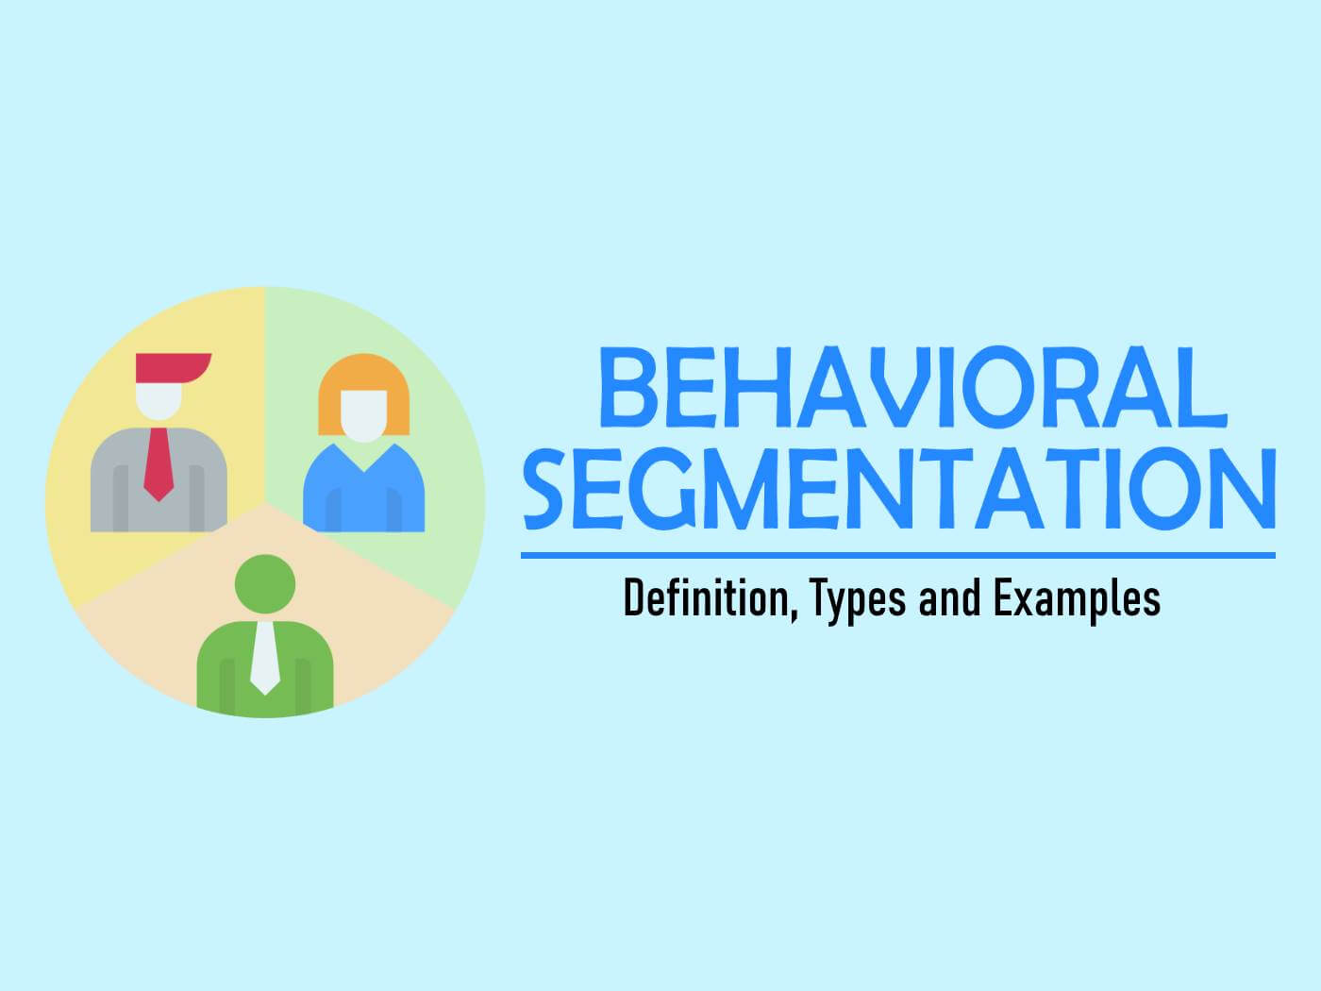
Segmentation
Behavioral Segmentation
Acquisition
User journey
Engagement
Retention
Discounts to Daily Customers or more products
Membership offers to Loyal Customers

Slide 7

Segmentation
Geographic Segmentation
Urban, suburban and rural
Population
Culture
Language
Climate

Slide 8

Segmentation
Psychographic Segmentation
Personality
Lifestyle
Identifying aspects of Consumer’s Personalities
Identifying aspects of Consumer’s Lifestyle to make offers

Slide 9
reference
Marketing Mix:
Key Elements
9

Slide 10
4P`S
Marketing mix:
PLACE
PRODUCT
PRICE
PROMOTION

Slide 11

4P’s
We are offering Genuine Products to our Customers with some warranty.
Our Price is minimum in Market and give vouchers on first product.
We have chosen a Place which is a hub for these types of products and the city which exports products all over the Country like Karachi, Lahore.
Our Promotion includes advertising, Special Discounts, and promotional strategy.

Slide 12
Target Market
Gamers, Streamers, Youtubers, Engineers and Beginners will be our target market.
High Demand of Computer and such devices in Lahore.
High Demand of Genuine Parts in Lahore.
Chance to expand our market from Hub.
Sell good product with less price.
Easy availability of Experienced Staff.
High Market Rate.

Slide 13
Market Position
Hafeez Centre, Lahore will be our market position.
Technology Related Market.
Customer get extra discounts on events/festivals.
Brand will be on Initial Position in starting.
Growing Business.
Unique Offers and Discounts for Customers.

Slide 14
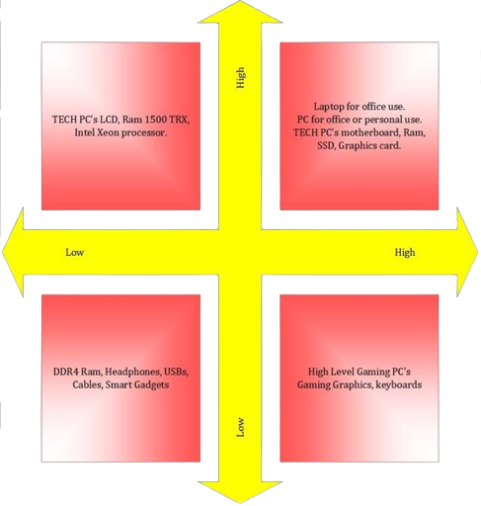
Perceptual Map

Slide 15
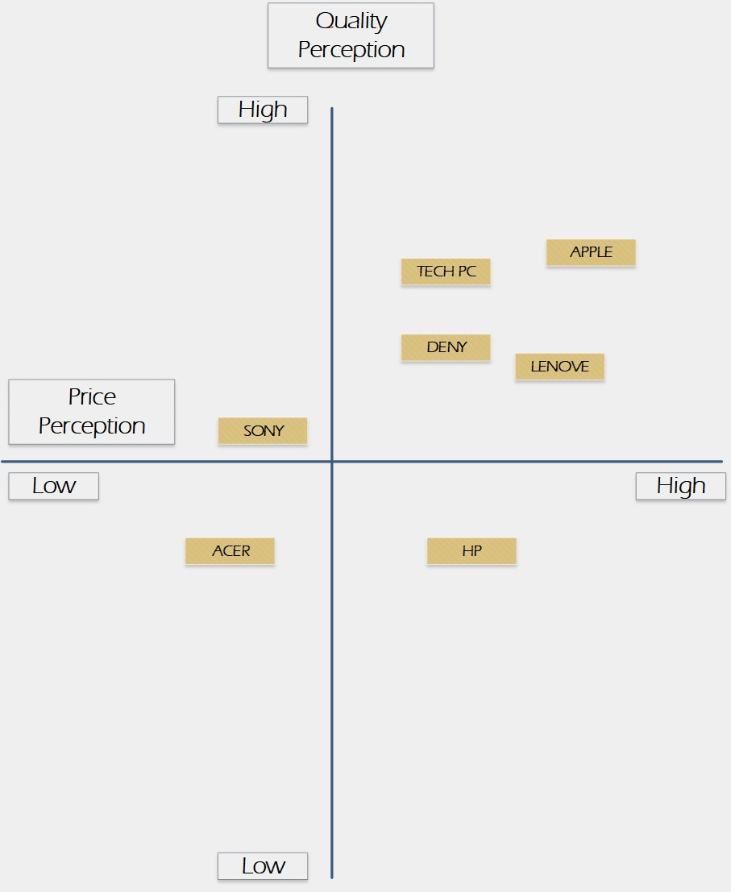
Perceptual Map Comparsion

Slide 16
SWOT
Special Deals
Massive Discounts
Genuine Product
1 Year Warranty
S
Market Pioneers
Competition
Established Market
W
Developing Market
Strategic Alliances
New Market Segments
O
New Competitor
Price Wars with Others
No Links in Market
Taxes
T

Slide 17
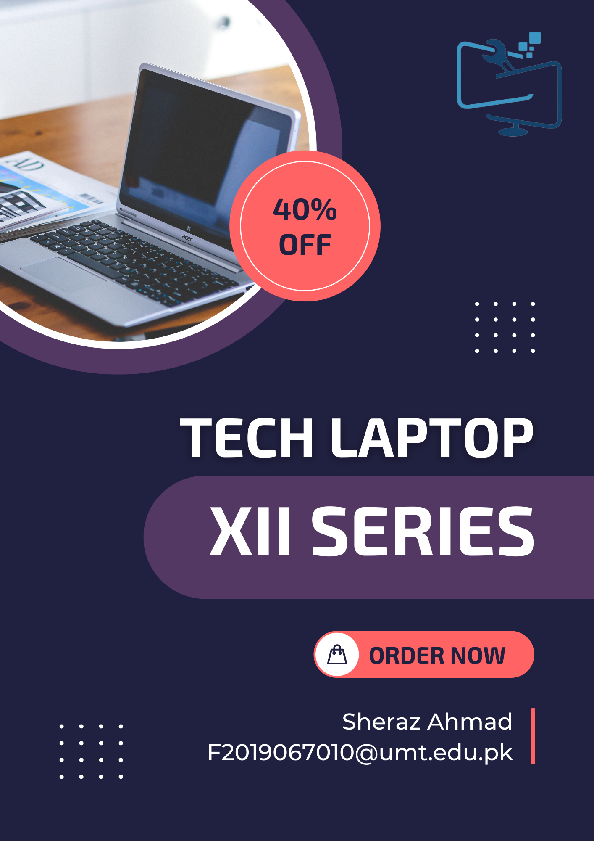
Add 1

Slide 18
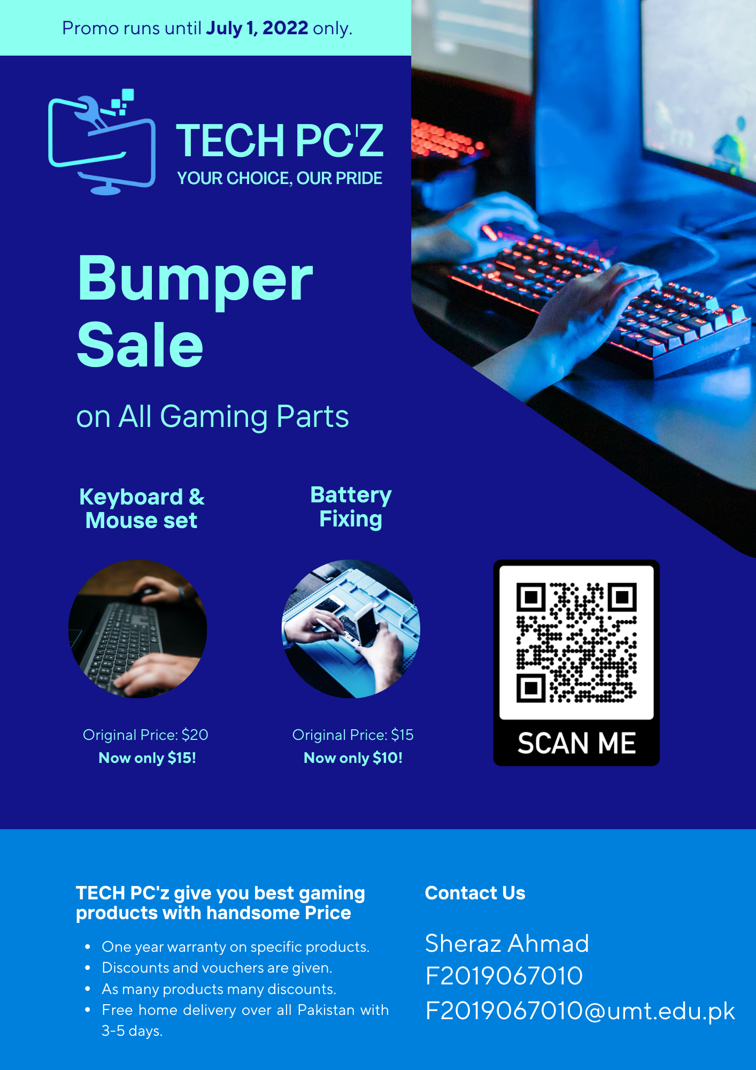
Add 2

Slide 19

TECH PC’z
Your Choice, Our Pride

